Slide 1

Body Fluid management:
then and now
SEPTEMBER 13th, 2024
IPAC SK
Saskatoon
Emanuel Couture-Armand

Slide 2
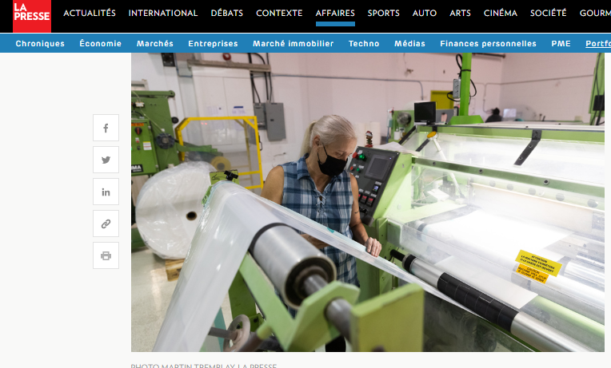
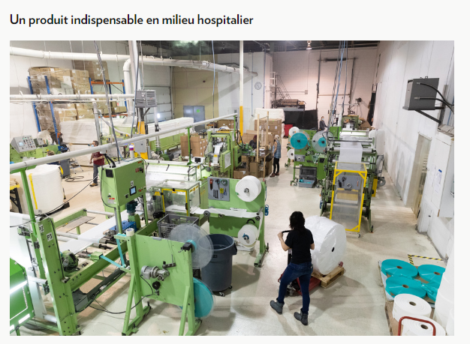

— Disclaimer

Slide 3






₂₀ countries
— Key facts
18years
₈patents
₄₅₀
tons of waste deviated annually from landfills to manufacture our products
+1000
Facilities use our products in Canada

Slide 4


Slide 5
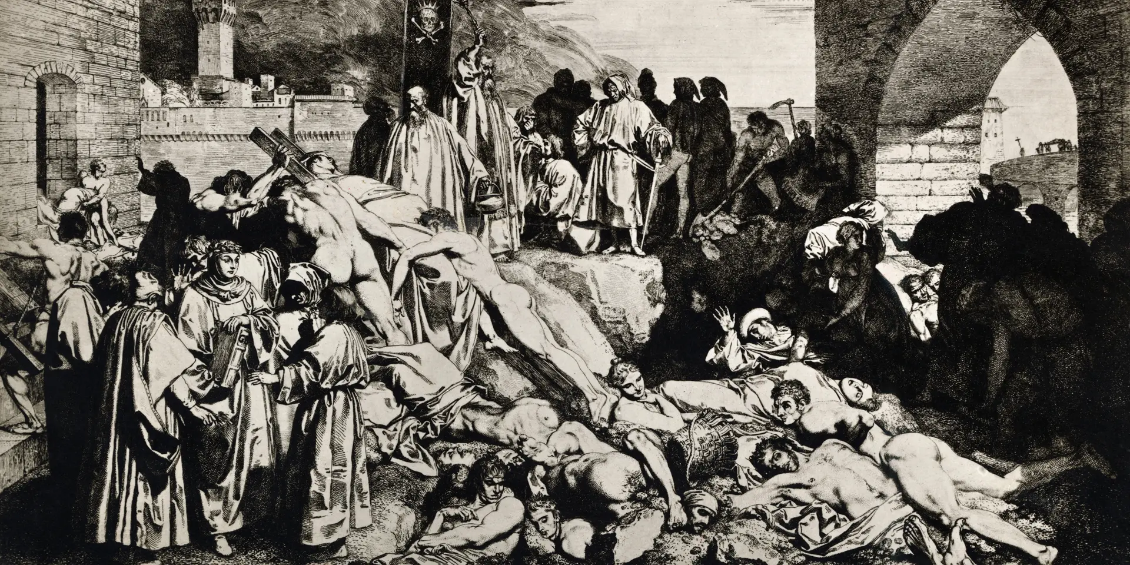

Slide 6
1846
1970
1850
1877
1910
1950
A recent preoccupation
1846: Ignace Simmelweiss – Hand Hygiene
1850: First antiseptic techniques
1877: First directive to isolate infectious patients
1910: Hand Hygiene – patient contact
1950: First infection control programs - MRSA
1970: First Isolation Protocol from the CDC
Notes:
On the scale of things, a recent preoccupation
Hand hygiene: 114 years later, still a daily battle and it still makes the news

Slide 7
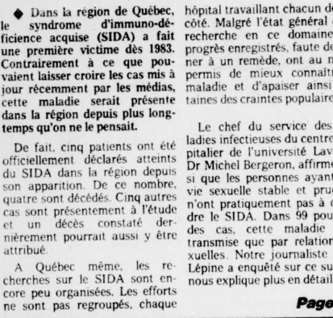
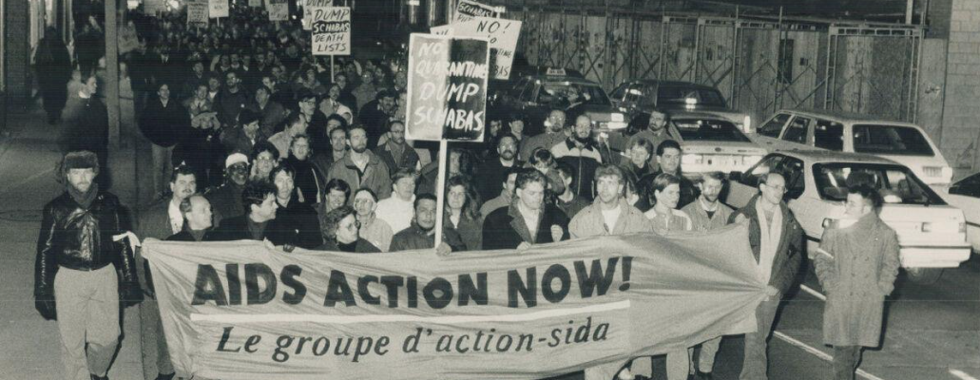
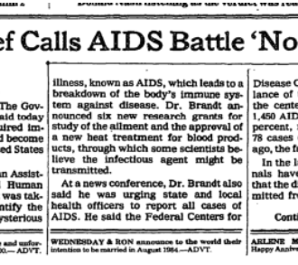
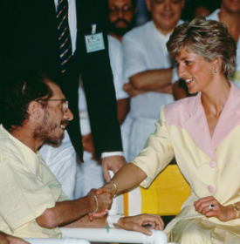
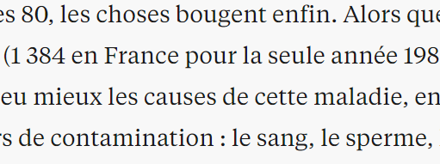
Notes:
It takes a crisis to move things quickly.
First wave was Aids and hepatitis C

Slide 8
80s:
New pathogens
Antibiotic resistance starts to emerge
Ambulatory services
Result:
Universal precautions (1985)
Isolation of ‘body fluids’
Sources :
1) MSSS, Principes généraux d’aménagement en prévention et en contrôle des infections nosocomiales. 2012
2) Rapport CDC 1988 https://www.cdc.gov/mmwr/preview/mmwrhtml/00000039.htm
1st Big wave of changes
Notes:
Universal precautions: patients & personnel
Linked to care activities, not diagnostics (no differentiation on the illness/source)
Focus on blood, not body fluids
Will be later incorporated into standard precautions, which will include excreta

Slide 9
Better, but still far from home!
2 to 8 patients per room/shared toilet
No hydro-alcoholic solutions
No sinks dedicated to hand hygiene
Clean and soiled material mixed
Commodes with cushions, leather, rusted, broken
Cotton gowns, shower heads, washers and macerators
No-fly zones (avoided by personnel)
Conformity to glove practices
IPAC = multi-task!
Notes:
No-fly zones: personnel avoids certain areas that are seen as dirty or unsafe
Gloves: tips are cut to take the pulse

Slide 10
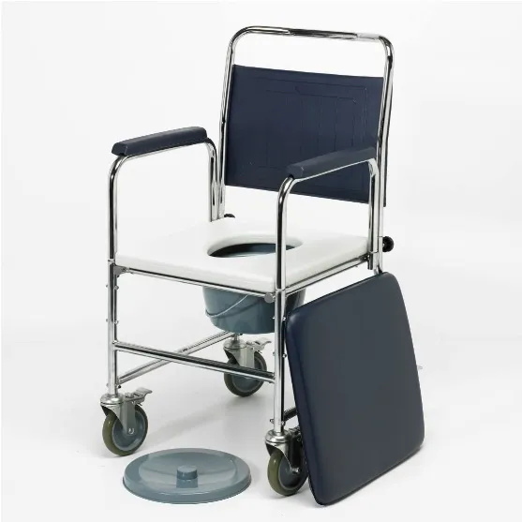
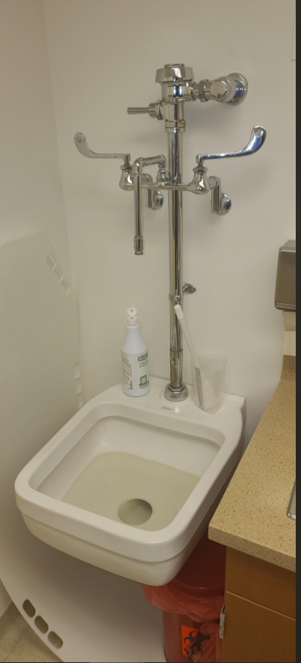
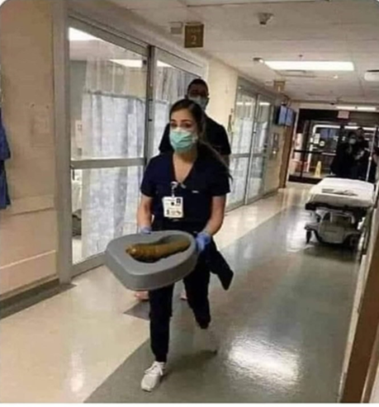
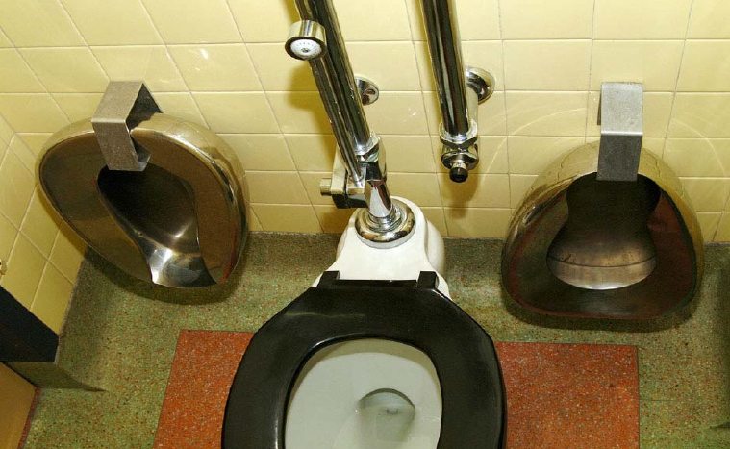
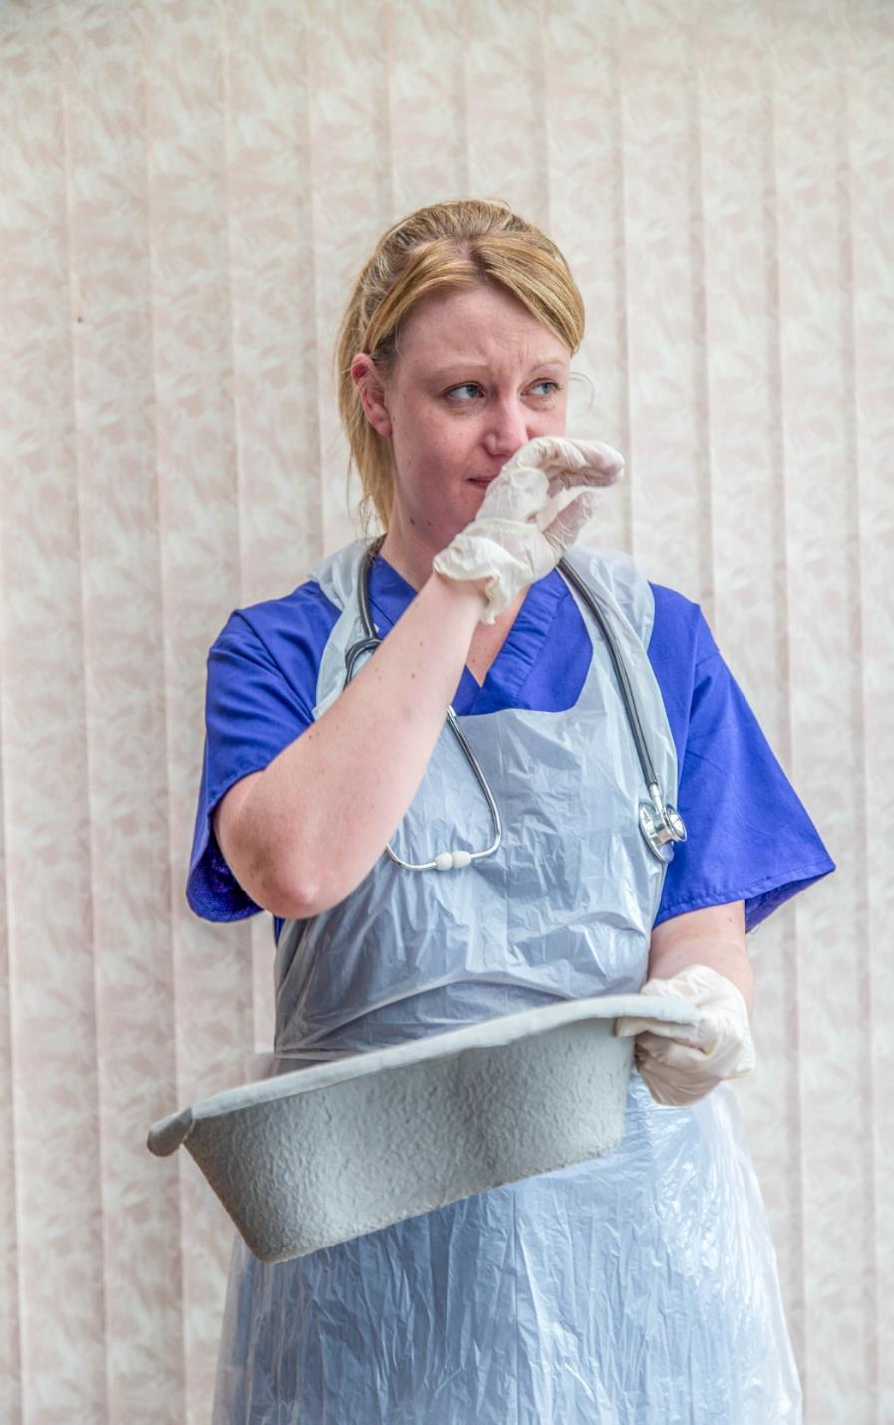
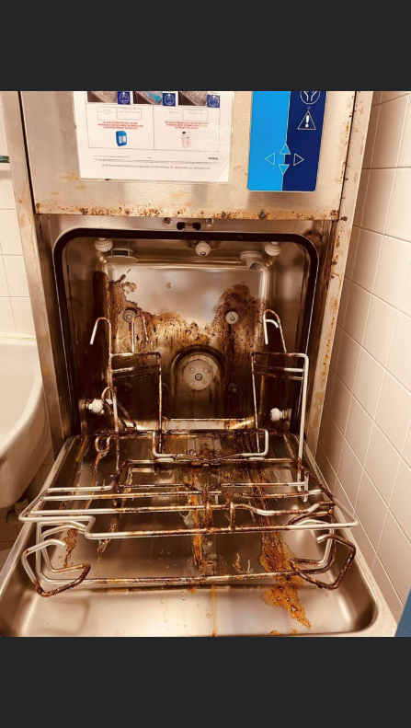
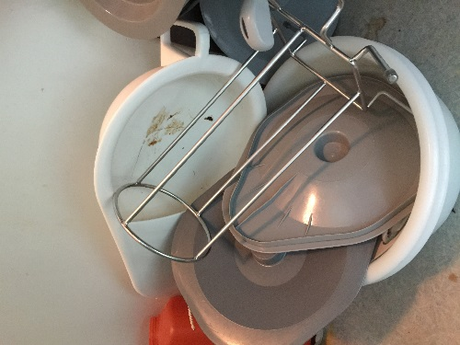
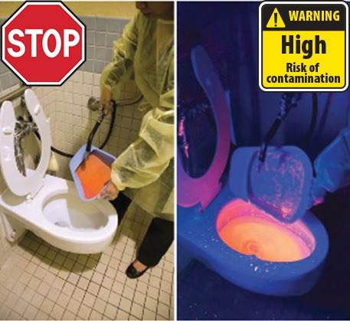
Notes:
I’d like to tell you that these pictures were taken decades ago, but no. Fairly common to this day!
Excreta management clearly the poor parent of IPAC

Slide 11
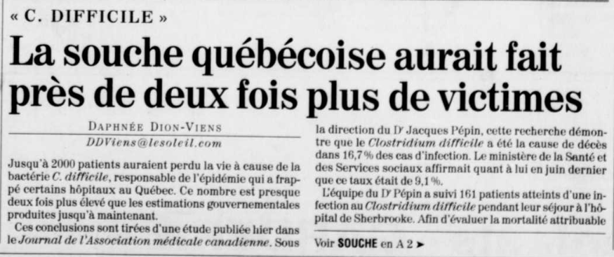
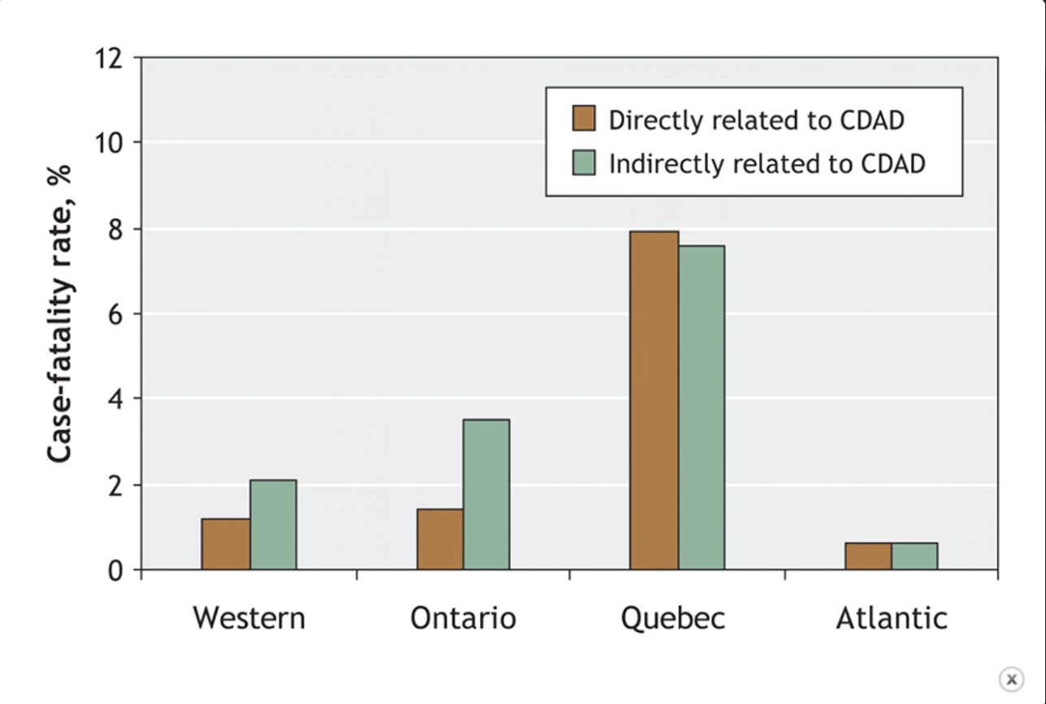
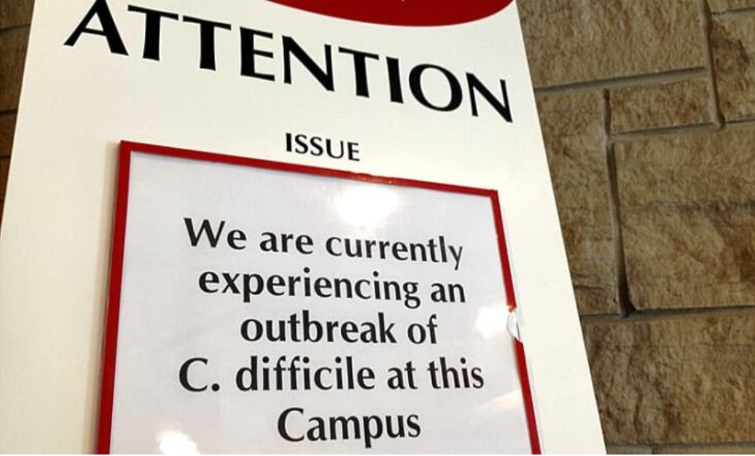
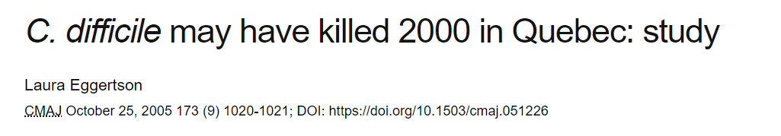
Notes:
Everything is put into question as clearly we weren’t ready for the new strain of C Diff that was way more dangerous.

Slide 12
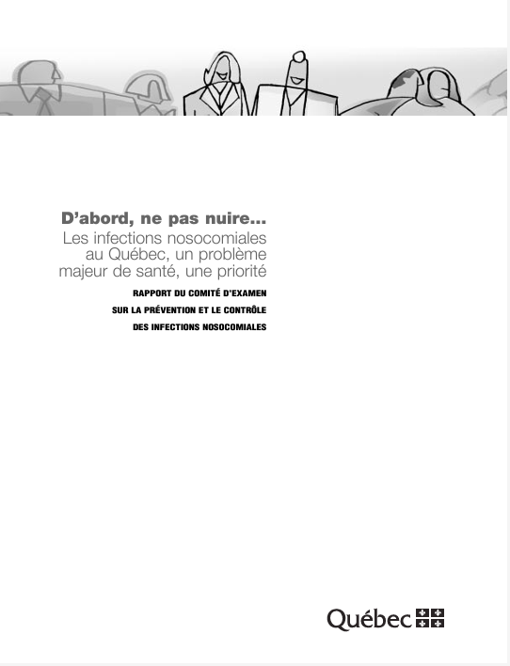
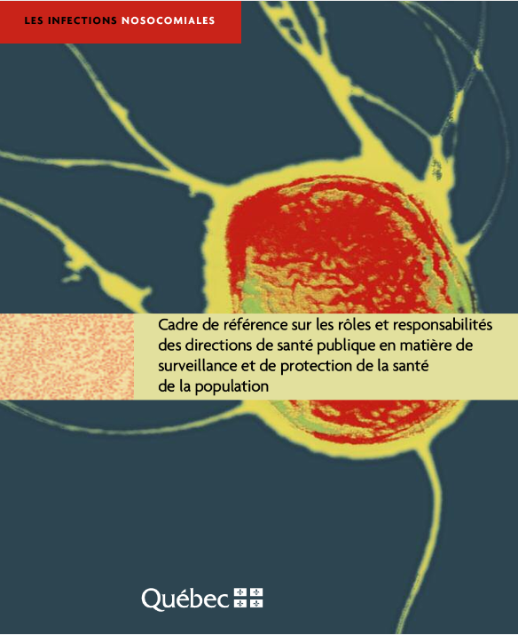

Slide 13
A lot of changes!
Standardization
IPAC nurses ratio
IPAC Culture

Slide 14
Isolation
Precaution levels
Regrouping / prioritizing
Dedicated material
Post-Mortem – Continued improvement
Hand Hygiene becomes fundamental
Zone signaling
Disinfection and maintenance protocols
Quality Audits
Routes and circuits for Medical and patient visits
Notes:
In short, a colossal effort to overhaul infection control. Hats off to those who contributed to this.

Slide 15
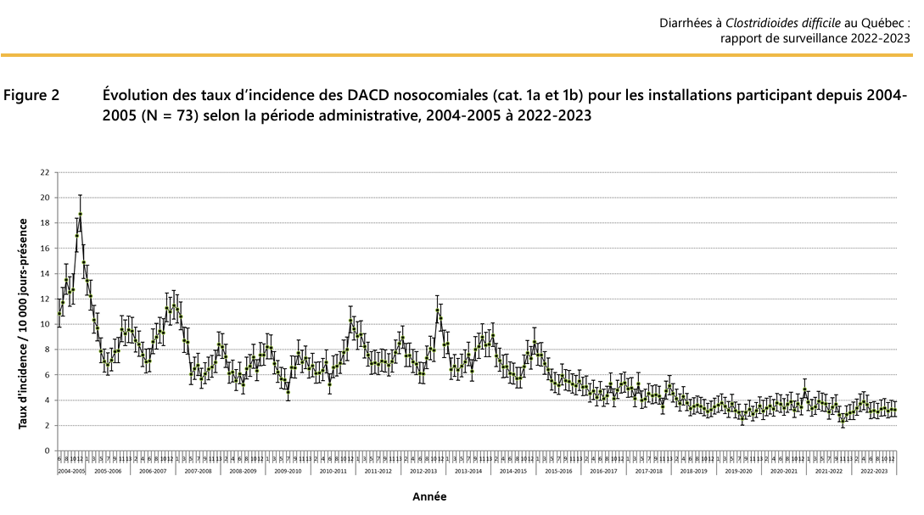
Notes:
And it works!
I’d be remiss not to point that Hygie is founded at the peak of this graph

Slide 16
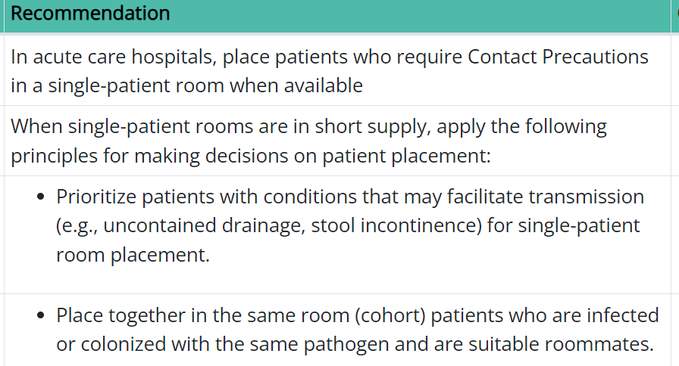
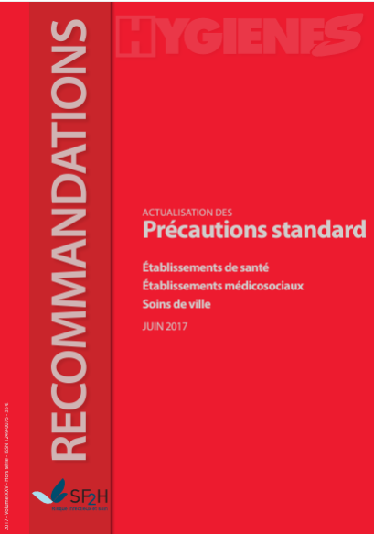

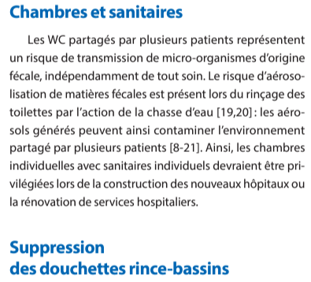
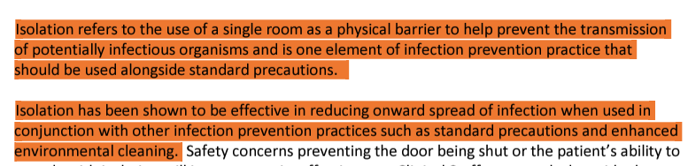


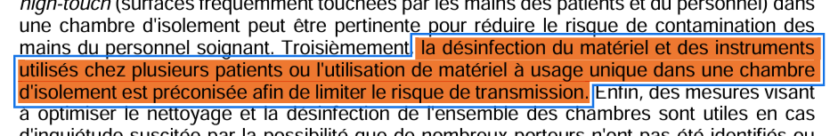
Notes:
IPAC guidelines as well will come afterwards
A coroner report is commissioned and a new guide for infection prevention
Europe: will come later. Still to this day, ratios of nurses are still way higher, some places 1 for 300 beds or more
In Asia: respiratory etiquette is more widely accepted and followed. But still IPC is understaffed, with Japan for example having 1 IPAC nurse for 500 beds.,
USA: 2008 before new official guidelines on CDIff by APICDiff par APIC. 1 APIC nurse for every 125 beds

Slide 17
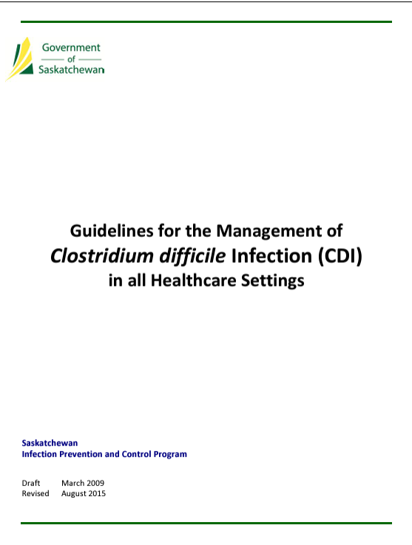
C.diff (and outbreak management)
Strongly recommended to use disposables
Forbids use of spray wands
Spores may not be eliminated by washer disinfectors
Notes:
Guidelines in Saskatchewan for C Diff – specific to body fluids

Slide 18
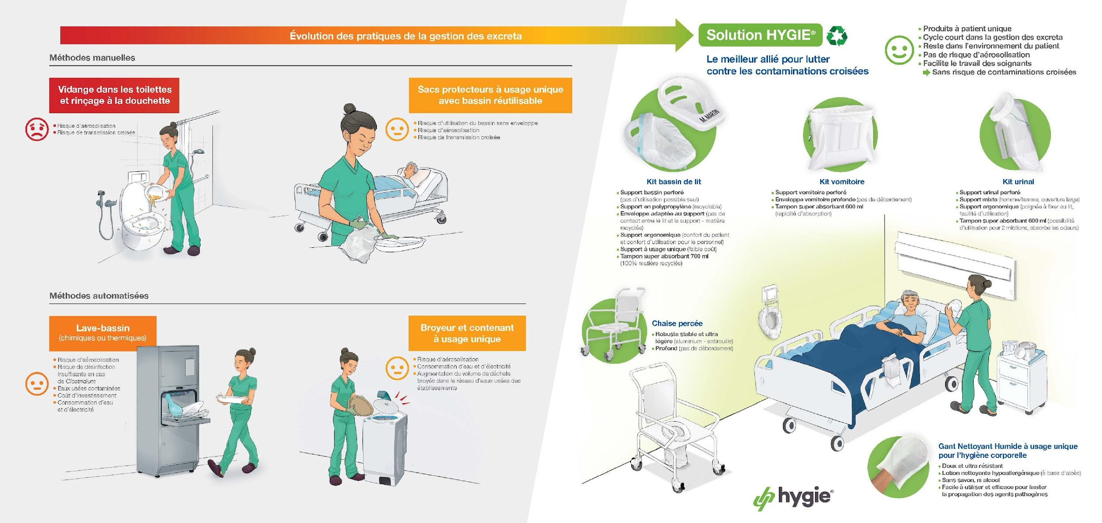
Current practices
Notes:
Many methods still in use today, case by case, or free for all sometimes.
Some situations clearly more shunned then others: wider incontinence protection, showerheads, underpads, manual cleaning, soaking, dump and run
Why all these methods? Poor parent, no clear guidelines
Compliance is always low, hard to prove the exact point of correlation, besides hand hygiene. Different thesis
Reprocessing of bedpans is the same thing.
IPAC is not a pure science
Without a consensus, we must rely on principle and knowledge of transmission

Slide 19
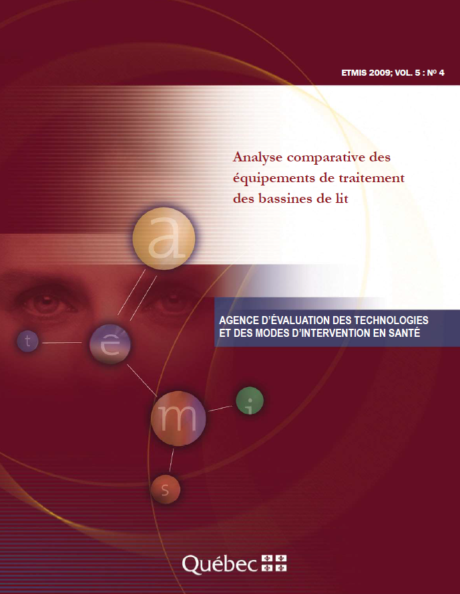
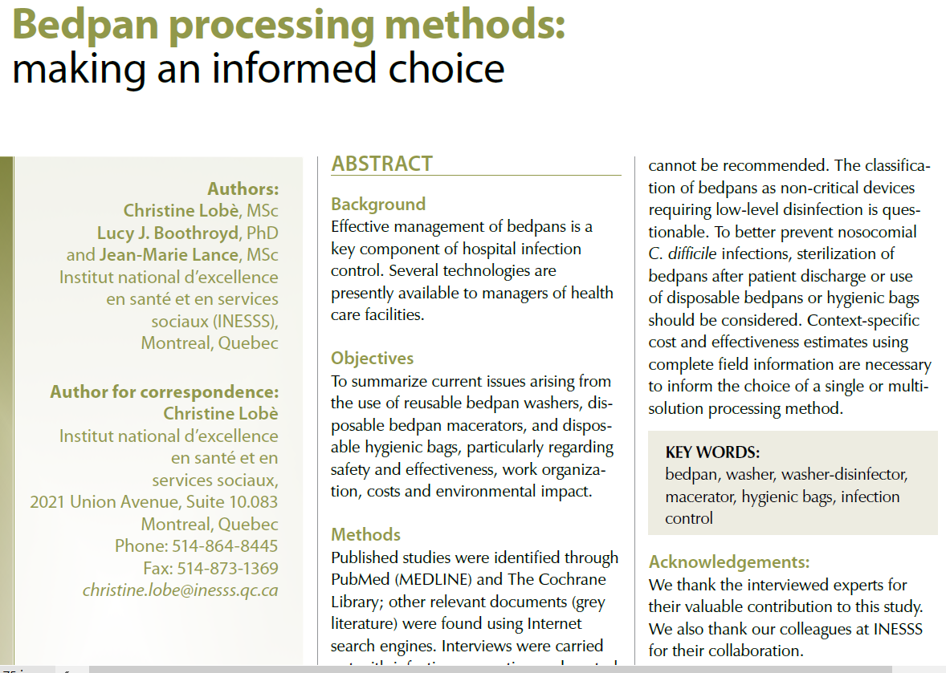

Slide 20
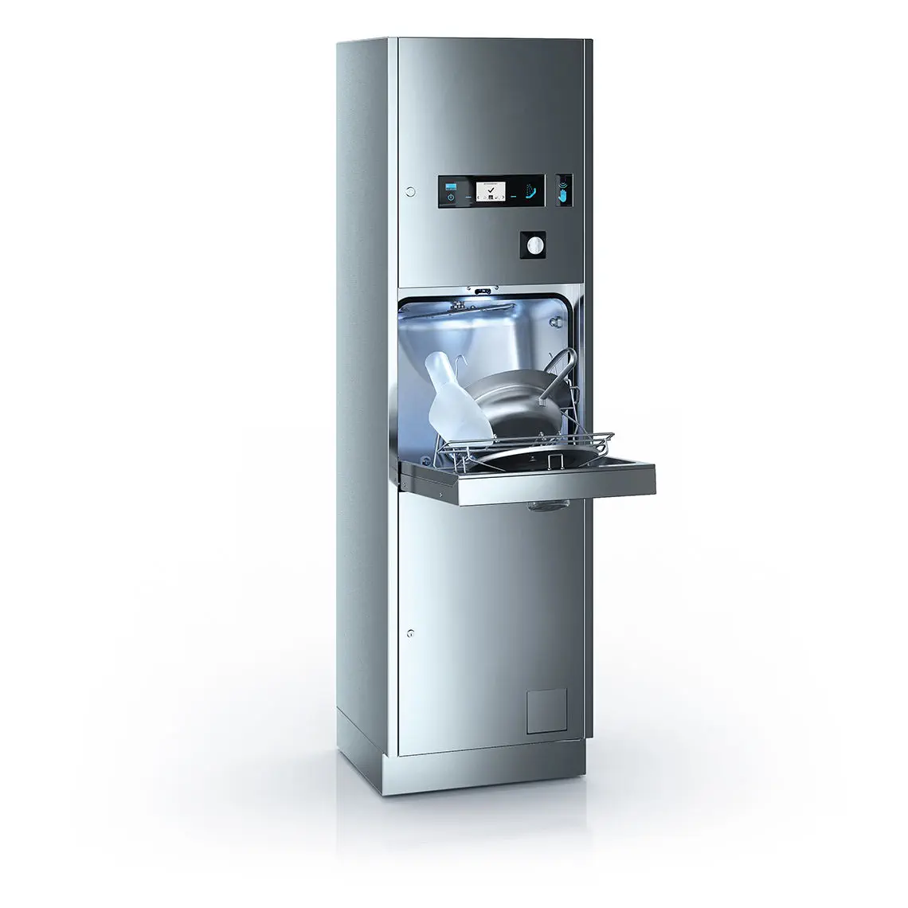
Issues raised by the literature:
Bedpan washers
Pernicious habits
Maintenance
Irregular parameters
Impossible to have in every room
Transport in hallways
Multi-patient
Loss of Time
Contingencies for shortages
Notes:
Point to situations exposed in congress and lived in facilities (ex. AIPI)
En plus, pour de la désinfection de haut niveau, il doit y avoir un nettoyage des matières organiques pour augmenter l’efficacité. Même chose pour la stérilisation
Ex. Manitoba, 1 year to repare a bedpan washer

Slide 21
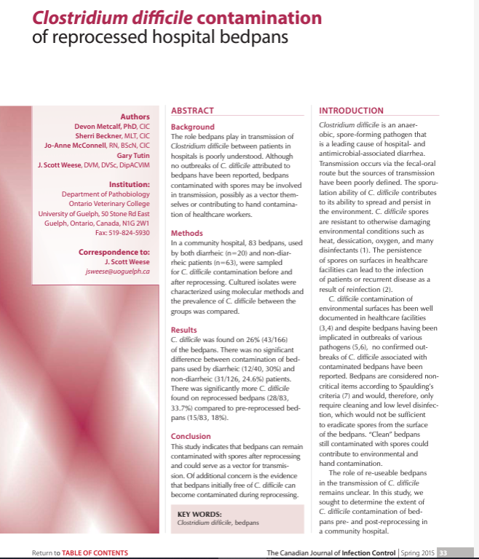
Other issues:
Inefficient disinfection
Reprocessing leads to further communications
Number of steps to follow for staff
Notes:
Guidelines in Saskatchewan for C Diff

Slide 22
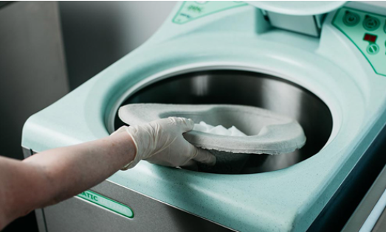
Issues raised by the literature:
Macerators
Contamination of reusable supports
Airborne contaminants
Hall transports
Frequent breakdowns
Piping retrofit or adaptation
Contingence for shortages
Recurring costs

Slide 23
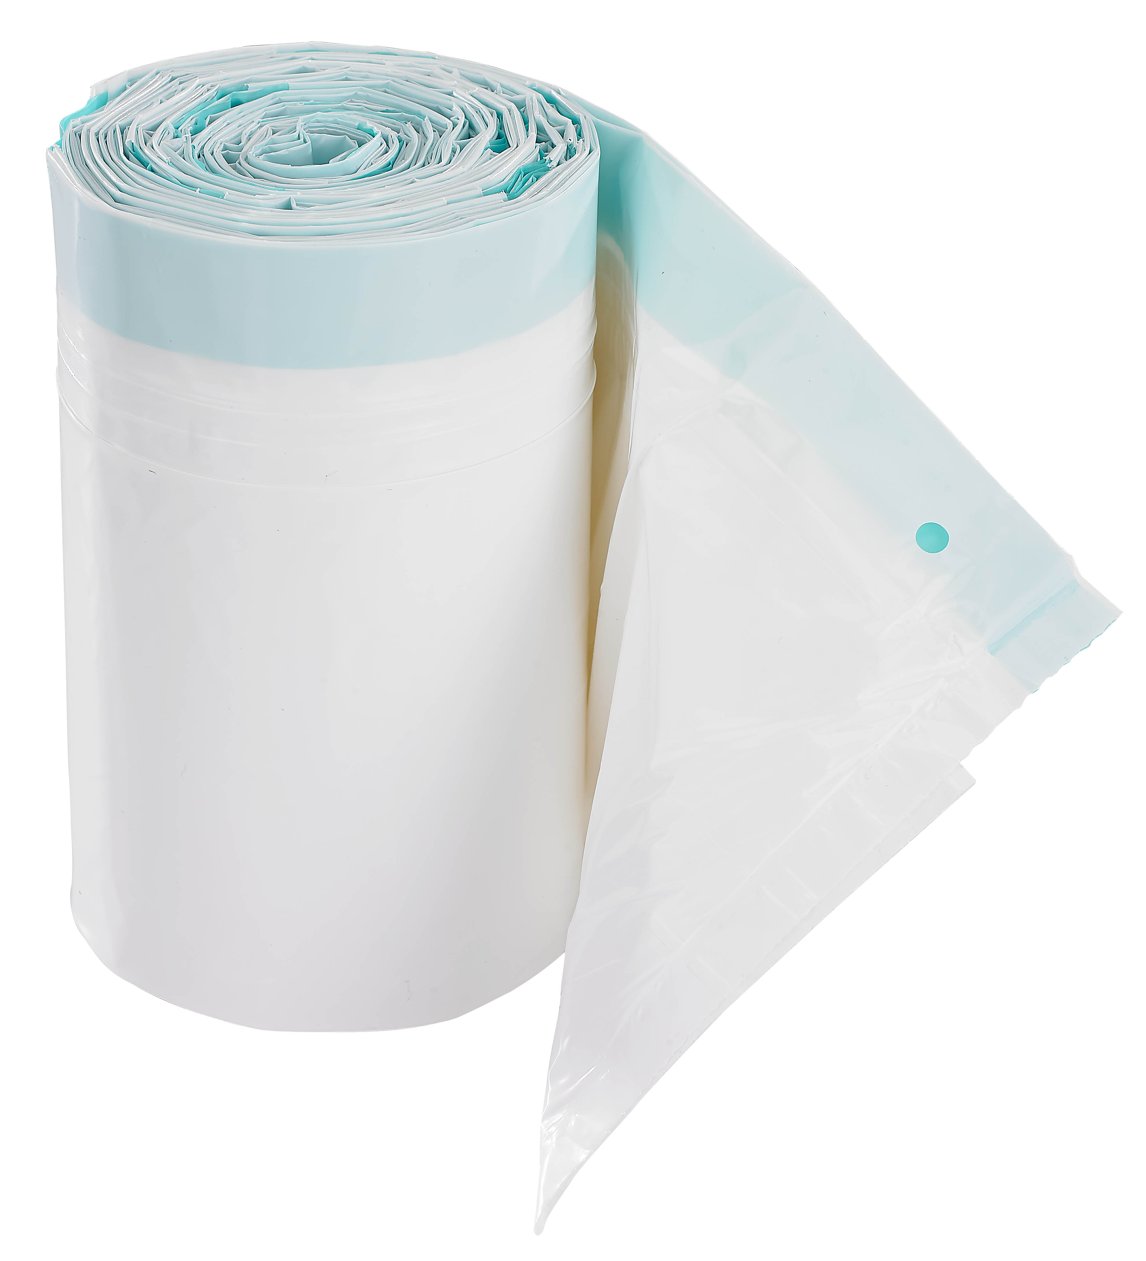
Issues raised by the literature:
Hygienic covers
Waste management
Recurring costs
Notes:
No issues linked to IPAC

Slide 24
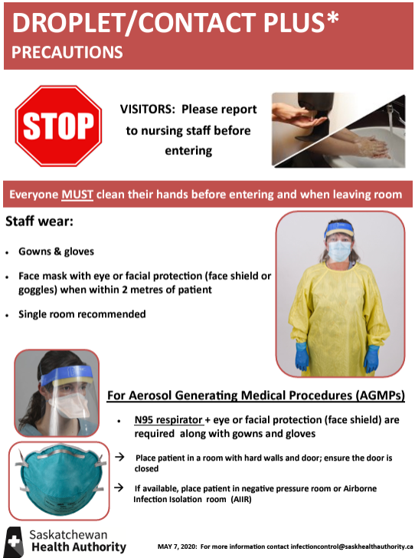
Outbreak management
Isolation
-Increased prevalence
-Nothing leaves the room
  -Dedicated material
Compliance
-Resistance to change
-Compliance to protocols
-Hand hygiene comparables
Notes:
COVID accentuated isolation, CPE and Gastro continue this trend
Hand hygiene numbers: all numbers point to a decrease of compliance numbers
40% to 80% range
Lowest amongst PSWs
Psychological toll of oversight and micromanagement on staff (both sides)

Slide 25
Outbreak management
Asymptomatic carriers
Precaution principle
-Clostridium difficile, EPC, Candida Auris, Influenza
-Short incubation periods
-Time to put in place the measures
Notes:
Treat all body fluids/excreta as contaminants

Slide 26
The future
More actions for body fluid management
More standardization, less guessing
Treat all body fluids like contaminants
Staff and time shortages are a reality and are not likely to lessen

Slide 27
The future - 2
Managing human errors is inevitable
Maintenance is problematic
Diminishing costs is a priority
Hospital waste: solutions exist!
As a team, everything is possible

Slide 28
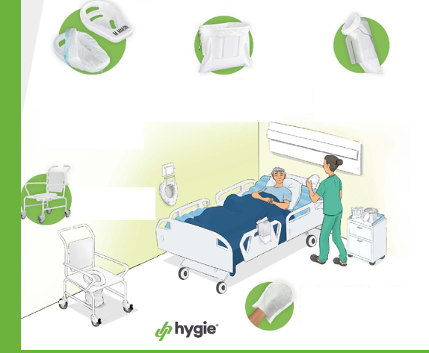
Single Patient concept
The only method that responds to all objectives in body fluid management with an IPAC lense. Whether for outbreaks or standard precautions:
Everything is kept at the point of care
100% compliance
No maintenance
No infrastructures
Time gain
Notes:
Methods that have existed for 50-60 years cannot be expected to produce different results

Slide 29
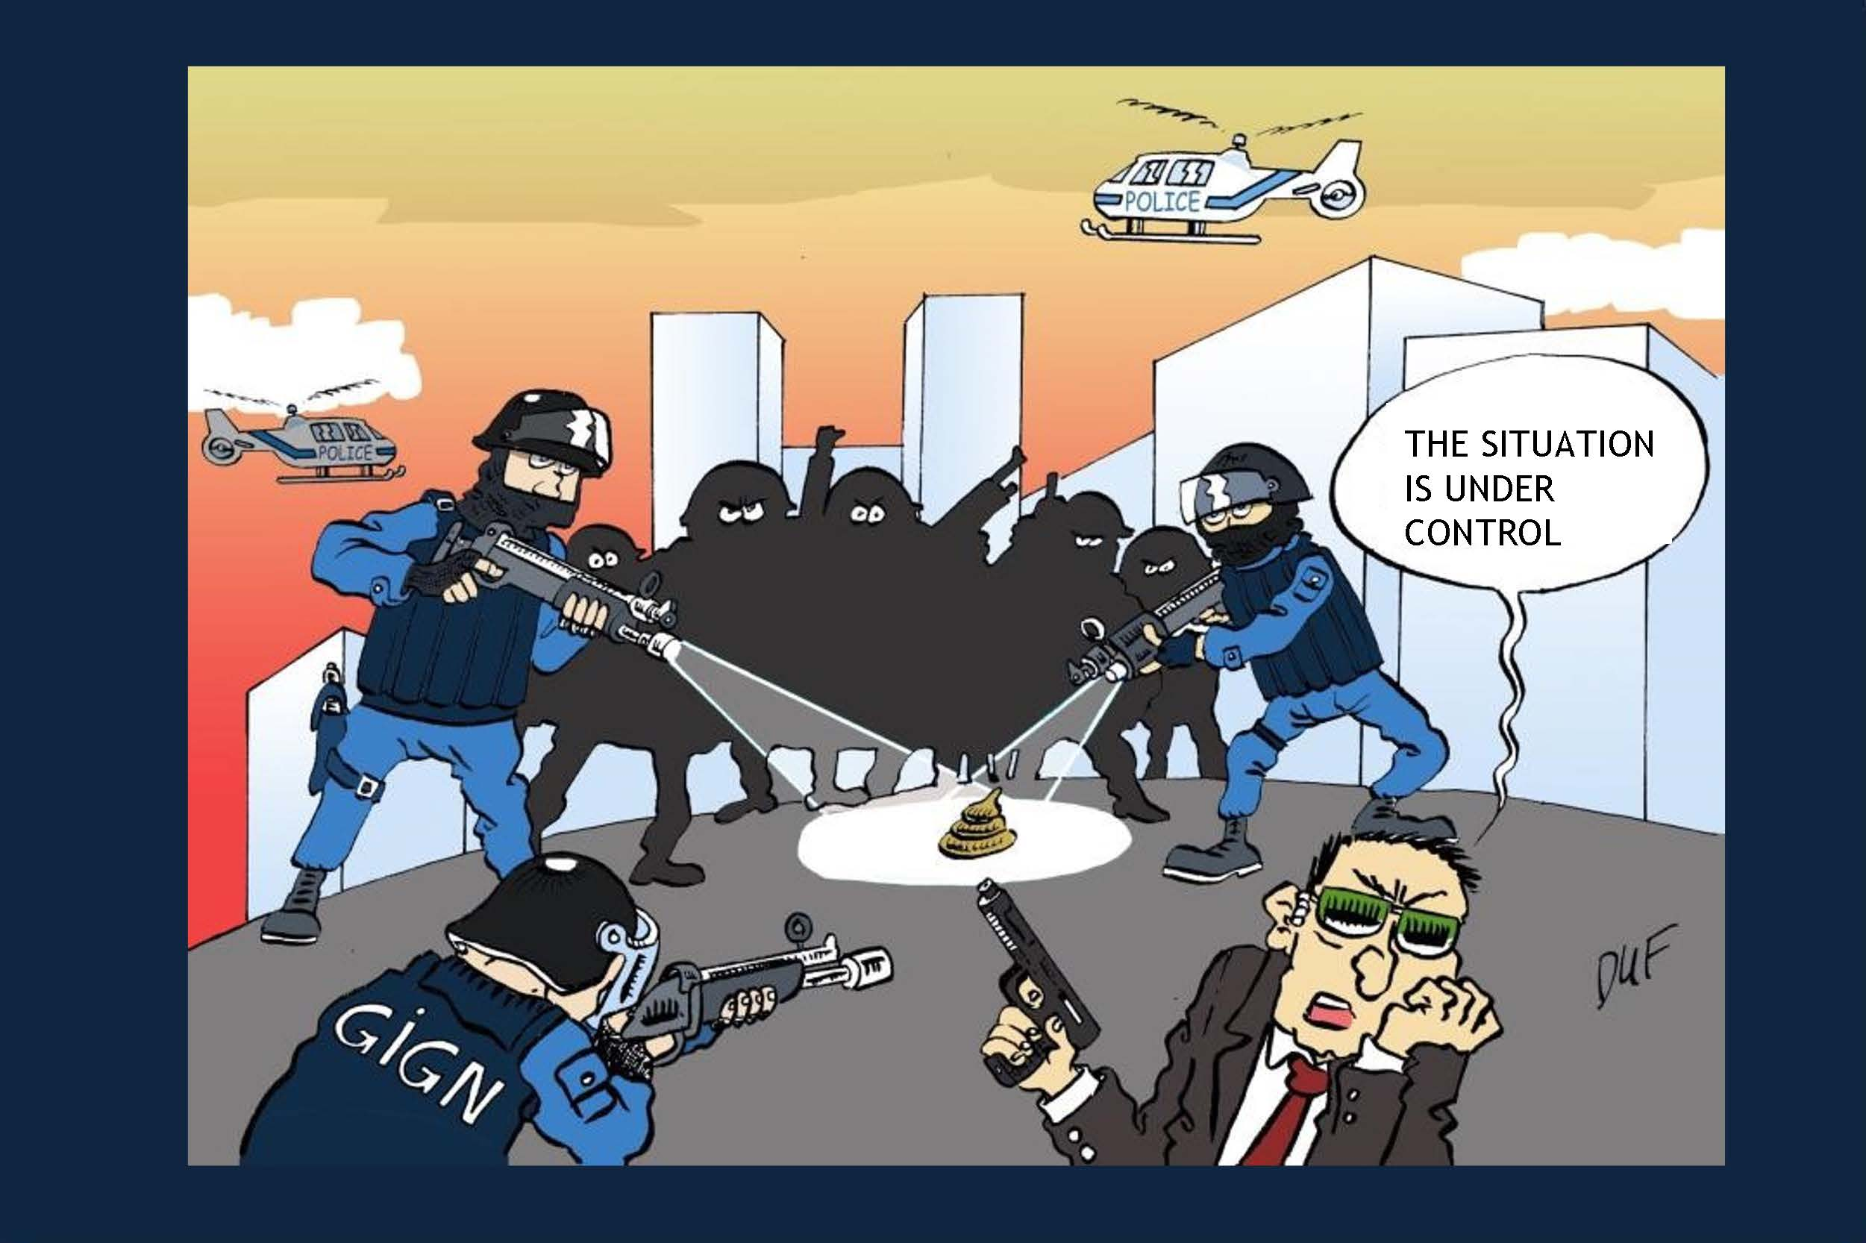

Slide 30


Contact
1.866.588.2221
info@hygie.com
Emanuel Couture-Armand
Director of Sales, Canada
514 791-0402
ecarmand@hygie.com
www.hygie.com

Slide 31

Together, let’s protect life!

